Slide 1
Introduction to UML

Slide 2
What is UML?
Unified Modeling Language
  OMG Standard, Object Management Group
UML is a modeling language to express and design documents, software
UML is a standard language for specifying, visualizing, constructing, and documenting the artifacts of software systems.
UML is a pictorial language used to make software blue prints.

Slide 3
Why use UML
Open Standard, Graphical notation for
  Specifying, visualizing, constructing, and documenting software systems
Language can be used from general initial design to very specific detailed design across the entire software development life cycle
Increase understanding/communication of product to customers and developers
Support for diverse application areas
Support for UML in many software packages today (e.g. Rational, plugins for popular IDE’s like NetBeans, Eclipse)
Based upon experience and needs of the user community
UML is a language, not a method

Slide 4
Goals of UML:
A picture is worth a thousand words.
UML diagrams are not only made for developers but also for business users, common people and anybody interested to understand the system.
UML can be defined as a simple modeling mechanism to model all possible practical systems in today.s complex environment.

Slide 5
Brief History
Inundated with methodologies in early 90’s
  Booch, Jacobson, Yourden, Rumbaugh
Booch, Jacobson merged methods 1994
Rumbaugh joined 1995
1997 UML 1.1 from OMG includes input from others, e.g. Yourden
UML v2.0 current version

Slide 6
Systems, Models and Views
A model is an abstraction describing a subset of a system
A view represents selected aspects of a model
A notation is a set of graphical or textual rules for representing views
Views and models of a single system may overlap each other
Examples:
System: Aircraft
Models: Flight simulator, scale model
Views: All blueprints, electrical wiring, fuel system

Slide 7
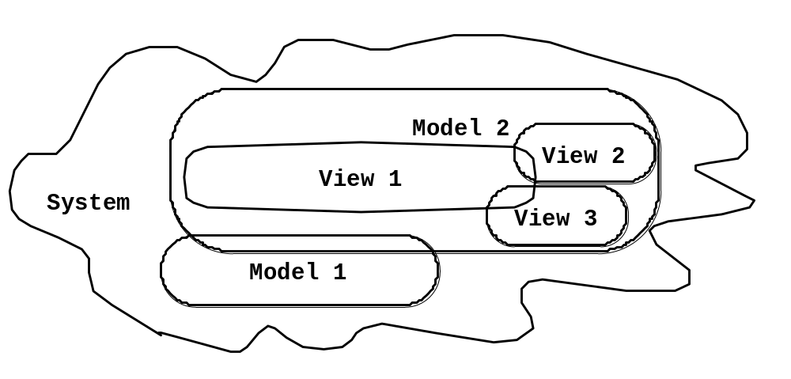
Systems, Models and Views
Flightsimulator
Blueprints
Aircraft
Electrical
Wiring
Scale Model

Slide 8
Object
  An object contains both data and methods that control the data.
  The data represents the state of the object.
  The objects are the real world entities that exist around us and the basic concepts like abstraction, encapsulation, inheritance, polymorphism all can be represented using UML.
© Wolfgang Pelz 2000-04
UML

Slide 9
Following are some fundamental concepts of object oriented world:
Objects: Objects represent an entity and the basic building block.
Class: Class is the blue print of an object.
Abstraction: Abstraction represents the behavior of an real world entity.
Encapsulation: Encapsulation is the mechanism of binding the data together and hiding them from outside world.
Inheritance: Inheritance is the mechanism of making new classes from existing one.
Polymorphism: It defines the mechanism to exists in different forms.

Slide 10
Overview (cont.)
interaction - set of objects and their relationships including messages
state/statechart - a state machine showing states, transitions, events, and activities
activity - statechart sequential flow of activities
component - physical structure of code in terms of code components
© Wolfgang Pelz 2000-04
UML

Slide 11
Overview (cont.)
deployment - physical architecture of hardware and software in the system
package - shows packages of classes and dependencies among them
  grouping mechanism
  form of class diagram
  also called subsystem
© Wolfgang Pelz 2000-04
UML

Slide 12
OO Analysis and Design
Object Oriented analysis can be defined as investigation and to be more specific it is the investigation of objects. Design means collaboration of identified objects.
So the purpose of OO analysis and design can described as:
Identifying the objects of a system.
Identify their relationships.
Make a design which can be converted to executables using OO languages.
There are three basic steps where the OO concepts are applied and implemented. The steps can be defined as
OO Analysis --> OO Design --> OO implementation using OO languages

Slide 13
UML - Architecture
Any real world system is used by different users.
The users can be developers, testers, business people, analysts and many more
UML plays an important role in defining different perspectives of a system. These perspectives are:
  Design
  Implementation
  Process
  Deployment

Slide 14
Contd…
Design of a system consists of classes, interfaces and collaboration. UML provides class diagram, object diagram to support this.
Implementation defines the components assembled together to make a complete physical system. UML component diagram is used to support implementation perspective.
Process defines the flow of the system. So the same elements as used in Design are also used to support this perspective.
Deployment represents the physical nodes of the system that forms the hardware. UML deployment diagram is used to support this perspective.

Slide 15
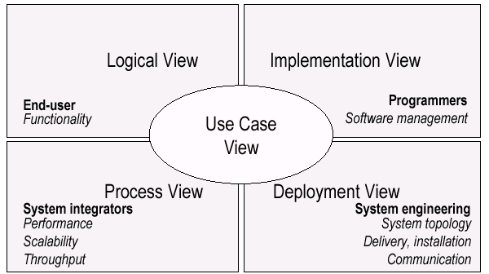
UML Models, Views, Diagrams
UML is a multi-diagrammatic language
  Each diagram is a view into a model
    Diagram presented from the aspect of a particular stakeholder
    Provides a partial representation of the system
    Is semantically consistent with other views
  Example views

Slide 16
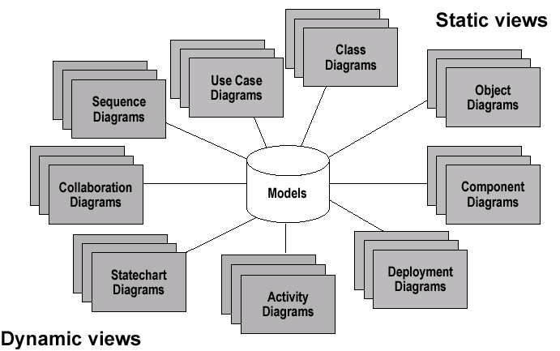
Models, Views, Diagrams

Slide 17
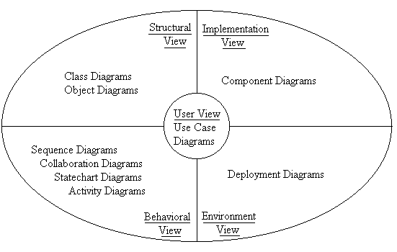
UML

Slide 18
How Many Views?
Views should to fit the context
  Not all systems require all views
  Single processor: drop deployment view
  Single process: drop process view
  Very small program: drop implementation view
A system might need additional views
  Data view, security view, …

Slide 19
UML: First Pass
You can model 80% of most problems by using about 20 % UML
We only cover the 20% here

Slide 20
Basic Modeling Steps
Use Cases
  Capture requirements
Domain Model
  Capture process, key classes
Design Model
  Capture details and behaviors of use cases and domain objects
  Add classes that do the work and define the architecture

Slide 21
UML Baseline
Use Case Diagrams
Class Diagrams
Package Diagrams
Interaction Diagrams
  Sequence
  Collaboration
Activity Diagrams
State Transition Diagrams
Deployment Diagrams

Slide 22
UML Diagrams
There are two broad caetgories of diagrams and then are again divided into sub-categories:
Structural Diagrams
Behavioral Diagrams

Slide 23
Structural Diagrams:
The structural diagrams represent the static aspect of the system.
These static aspects represent those parts of a diagram which forms the main structure and therefore stable.
These static parts are represents by classes, interfaces, objects, components and nodes. The four structural diagrams are:
    Class diagram
    Object diagram
    Component diagram
    Deployment diagram

Slide 24
Behavioral Diagrams:
Any system can have two aspects, static and dynamic. So a model is considered as complete when both the aspects are covered fully.
Behavioral diagrams basically capture the dynamic aspect of a system.
Dynamic aspect can be further described as the changing/moving parts of a system.
UML has the following five types of behavioral diagrams:
  Use case diagram
  Sequence diagram
  Collaboration diagram
  Statechart diagram
  Activity diagram

Slide 25
Use case Diagram:
Use case diagrams are a set of
    use cases,
    actors and
    their relationships.
They represent the use case view of a system.
A use case represents a particular functionality of a system.
So use case diagram is used to describe the relationships among the functionalities and their internal/external controllers. These controllers are known as actors.

Slide 26
Use Case Diagrams
Used during requirements elicitation to represent external behavior
Actors represent roles, that is, a type of user of the system
Use cases represent a sequence of interaction for a type of functionality; summary of scenarios
The use case model is the set of all use cases. It is a complete description of the functionality of the system and its environment
Passenger
PurchaseTicket

Slide 27

Use case Diagram:

Slide 28
Actors
An actor models an external entity which communicates with the system:
  User
  External system
  Physical environment
An actor has a unique name and an optional description.
Examples:
  Passenger: A person in the train
  GPS satellite: Provides the system with GPS coordinates
Passenger

Slide 29
Use Case
A use case represents a class of functionality provided by the system as an event flow.
A use case consists of:
Unique name
Participating actors
Entry conditions
Flow of events
Exit conditions
Special requirements
PurchaseTicket

Slide 30
Use Case Diagram: Example
Name: Purchase ticket
Participating actor: Passenger
Entry condition:
Passenger standing in front of ticket distributor.
Passenger has sufficient money to purchase ticket.
Exit condition:
Passenger has ticket.
Event flow:
1. Passenger selects the number of zones to be traveled.
2. Distributor displays the amount due.
3. Passenger inserts money, of at least the amount due.
4. Distributor returns change.
5. Distributor issues ticket.
Anything missing?
Exceptional cases!

Slide 31
Relationships Between Use Cases
Use cases could be organized using following relationships:
generalization
association
extend
include

Slide 32
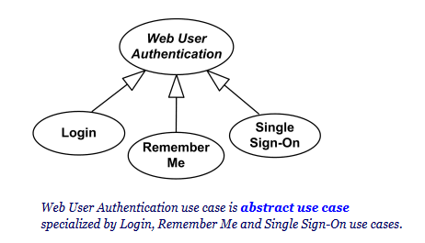
Generalization Between Use Cases
Generalization between use cases is similar to generalization between classes – child use case inherits properties and behavior of the parent use case and may override the behavior of the parent.
Generalization is shown as a solid directed line with a large hollow triangle arrowhead, the same as for generalization between classifiers, directed from the more specific use case to the general use case.

Slide 33
Association Between Use Cases
Use cases can only be involved in binary associations

Slide 34
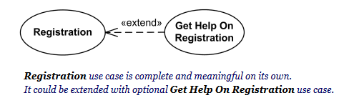
UML Use Case Extend
Extend is a directed relationship that specifies how and when the behavior defined in usually supplementary (optional) extending use case can be inserted into the behavior defined in the extended use case.
Extend relationship is shown as a dashed line with an open arrowhead directed from the extending use case to the extended (base) use case. The arrow is labeled with the keyword «extend».

Slide 35
The <<extends>> Relationship
<<extends>> relationships represent exceptional or seldom (infrequently) invoked cases.
The exceptional event flows are factored out of the main event flow for clarity.
Use cases representing exceptional flows can extend more than one use case.
The direction of a <<extends>> relationship is to the extended use case
Passenger
PurchaseTicket
<<extends>>
<<extends>>
<<extends>>
OutOfOrder
<<extends>>
TimeOut
Cancel
NoChange

Slide 36
UML Use Case Include
The include relationship could be used:
to simplify large use case by splitting it into several use cases,
to extract common parts of the behaviors of two or more use cases

Slide 37
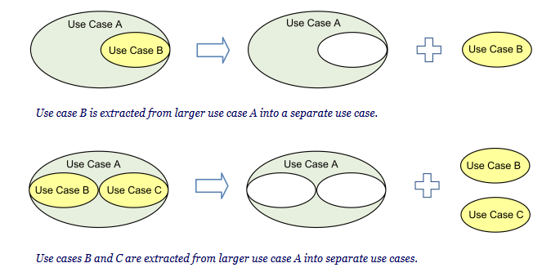

Slide 38
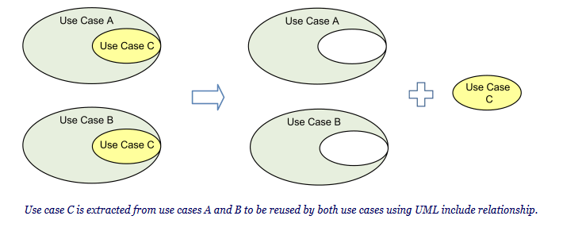
When two or more use cases have some common behavior, this common part could be extracted into a separate use case to be included back by the use cases with the UML include relationship.

Slide 39
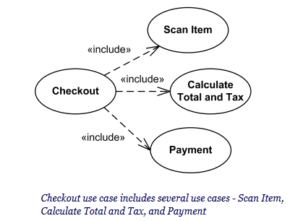
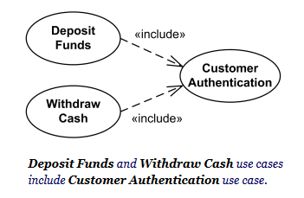

Slide 40
The <<includes>> Relationship
<<includes>> relationship represents behavior that is factored out of the use case.
<<includes>> behavior is factored out for reuse, not because it is an exception.
The direction of a <<includes>> relationship is to the using use case (unlike <<extends>> relationships).
Passenger
PurchaseMultiCard
PurchaseSingleTicket
<<includes>>
<<includes>>
<<extends>>
CollectMoney
<<extends>>
NoChange
Cancel

Slide 41
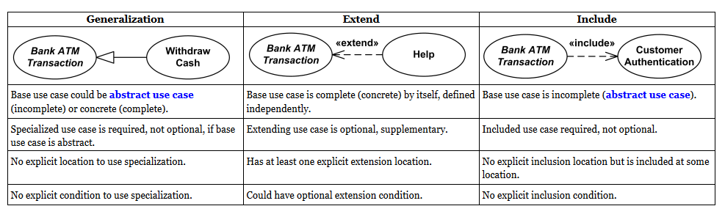
Use Case Relationships Compared

Slide 42
Use Cases are useful to…
Determining requirements
  New use cases often generate new requirements as the system is analyzed and the design takes shape.
Communicating with clients
  Their notational simplicity makes use case diagrams a good way for developers to communicate with clients.
Generating test cases
  The collection of scenarios for a use case may suggest a suite of test cases for those scenarios.

Slide 43
Use Case Diagrams: Summary
Use case diagrams represent external behavior
Use case diagrams are useful as an index into the use cases
Use case descriptions provide meat of model, not the use case diagrams.
All use cases need to be described for the model to be useful.

Slide 44
Class Diagrams
Gives an overview of a system by showing its classes and the relationships among them.
  Class diagrams are static
  they display what interacts but not what happens when they do interact
Also shows attributes and operations of each class
Good way to describe the overall architecture of system components

Slide 45
Class Diagram Perspectives
We draw Class Diagrams under three perspectives
  Conceptual
    Software independent
    Language independent
  Specification
    Focus on the interfaces of the software
  Implementation
    Focus on the implementation of the software

Slide 46
Classes – Not Just for Code
TariffSchedule
Table zone2price
Enumeration getZones()
Price getPrice(Zone)
Name
TariffSchedule
Attributes
Signature
zone2price
getZones()
getPrice()
Operations
TariffSchedule
A class represent a concept
A class encapsulates state (attributes) and behavior (operations).
Each attribute has a type.
Each operation has a signature.
The class name is the only mandatory information.

Slide 47
Instances
tarif_1974:TariffSchedule
zone2price = {
{‘1’, .20},
{‘2’, .40},
{‘3’, .60}}
An instance represents a phenomenon.
The name of an instance is underlined and can contain the class of the instance.
The attributes are represented with their values.

Slide 48
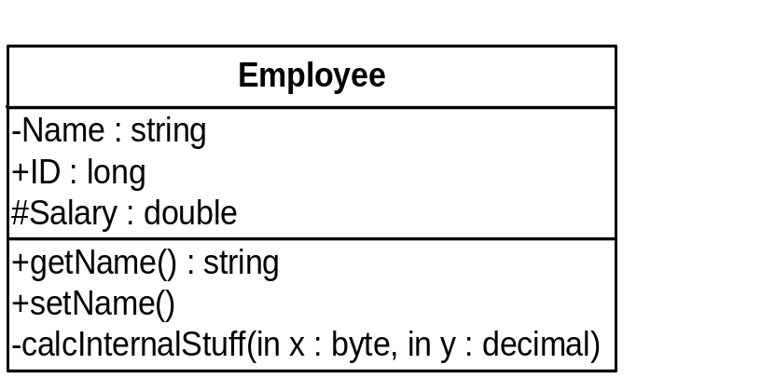
UML Class Notation
A class is a rectangle divided into three parts
  Class name
  Class attributes (i.e. data members, variables)
  Class operations (i.e. methods)
Modifiers
  Private: -
  Public: +
  Protected: #
  Static: Underlined (i.e. shared among all members of the class)
Abstract class: Name in italics

Slide 49
UML Class Notation
Lines or arrows between classes indicate relationships
  Association
    A relationship between instances of two classes, where one class must know about the other to do its work, e.g. client communicates to server
    indicated by a straight line or arrow
  Aggregation
    An association where one class belongs to a collection, e.g. instructor part of Faculty
    Indicated by an empty diamond on the side of the collection
  Composition
    Strong form of Aggregation
    Lifetime control; components cannot exist without the aggregate
    Indicated by a solid diamond on the side of the collection
  Inheritance
    An inheritance link indicating one class a superclass relationship, e.g. bird is part of mammal
    Indicated by triangle pointing to superclass

Slide 50

Binary Association
Binary Association: Both entities “Know About” each other
myB.service();
myA.doSomething();
Optionally, may create an Associate Class

Slide 51

Unary Association
A knows about B, but B knows nothing about A
myB.service();
Arrow points in direction
of the dependency

Slide 52

Aggregation
Aggregation is an association with a “collection-member” relationship
void doSomething()
aModule.service();
Hollow diamond on
the Collection side
No sole ownership implied

Slide 53
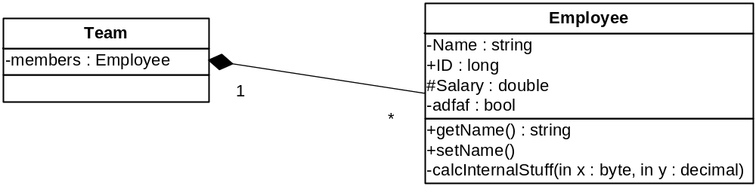
Composition
Composition is Aggregation with:
Lifetime Control (owner controls construction, destruction)
Part object may belong to only one whole object
members[0] =
new Employee();
…
delete members[0];
Filled diamond on side of the Collection

Slide 54
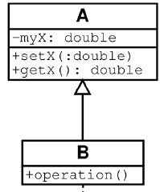
Inheritance
Standard concept of inheritance
Base Class
Derived Class
class B() extends A
…

Slide 55
UML Multiplicities
Links on associations to specify more details about the relationship
Multiplicities | Meaning
0..1 | zero or one instance. The notation n . . m indicates n to m instances.
0..* or * | no limit on the number of instances (including none).
1 | exactly one instance
1..* | at least one instance

Slide 56
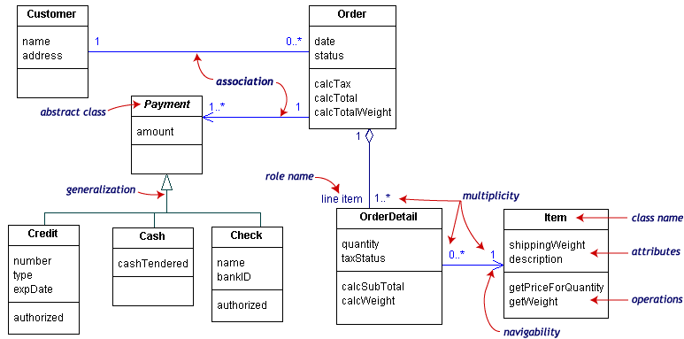
UML Class Example

Slide 57
Association Details
Can assign names to the ends of the association to give further information
Team
-
Employee
group
-
Name
:
string
-
members
:
Employee
-
individual
+
ID
:
long
1
#
Salary
:
double
*
-
adfaf
:
bool
+
getName
() :
string
+
setName
()
-
calcInternalStuff
(
in x
:
byte
,
in y
:
decimal
)

Slide 58
Static vs. Dynamic Design
Static design describes code structure and object relations
  Class relations
  Objects at design time
  Doesn’t change
Dynamic design shows communication between objects
  Similarity to class relations
  Can follow sequences of events
  May change depending upon execution scenario
  Called Object Diagrams

Slide 59
Object Diagrams
Shows instances of Class Diagrams and links among them
  An object diagram is a snapshot of the objects in a system
    At a point in time
    With a selected focus
      Interactions – Sequence diagram
      Message passing – Collaboration diagram
      Operation – Deployment diagram

Slide 60
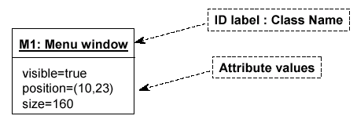
Object Diagrams
Format is
  Instance name : Class name
  Attributes and Values
  Example:

Slide 61
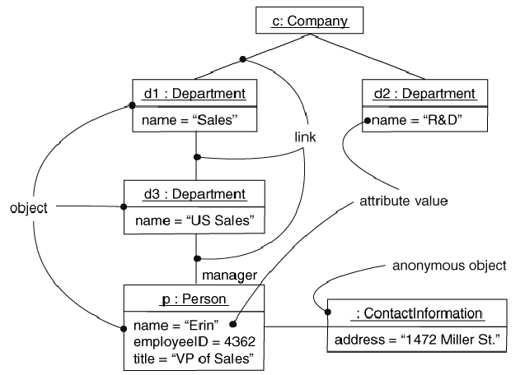
Objects and Links
Can add association type and also message type

Slide 62
Package Diagrams
To organize complex class diagrams, you can group classes into packages. A package is a collection of logically related UML elements
Notation
  Packages appear as rectangles with small tabs at the top.
  The package name is on the tab or inside the rectangle.
  The dotted arrows are dependencies. One package depends on another if changes in the other could possibly force changes in the first.
  Packages are the basic grouping construct with which you may organize UML models to increase their readability

Slide 63
Package Example
DispatcherInterface
Notification
IncidentManagement

Slide 64
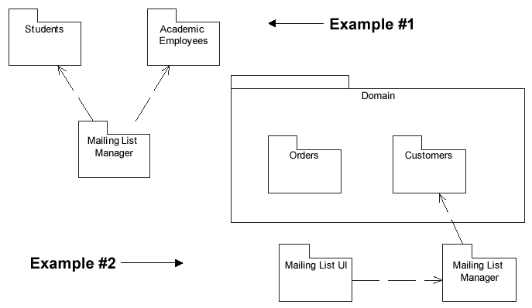
More Package Examples

Slide 65
Interaction Diagrams
Interaction diagrams are dynamic -- they describe how objects collaborate.
A Sequence Diagram:
  Indicates what messages are sent and when
  Time progresses from top to bottom
  Objects involved are listed left to right
  Messages are sent left to right between objects in sequence

Slide 66
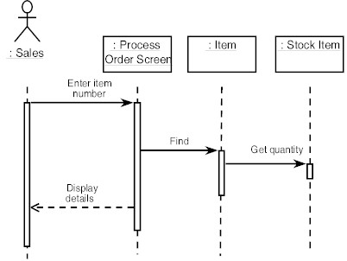
Sequence Diagram Format
Actor from
Use Case
Objects
1
Activation
2
3
4
Lifeline
Calls = Solid Lines
Returns = Dashed Lines

Slide 67
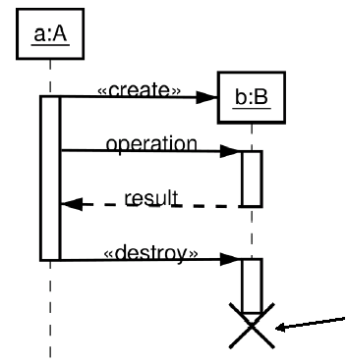
Sequence Diagram : Destruction
Shows Destruction of b
(and Construction)

Slide 68
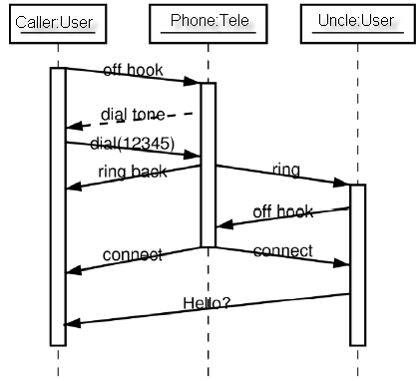
Sequence Diagram : Timing
Slanted Lines show propagation delay of messages
Good for modeling real-time systems
If messages cross this is usually problematic – race conditions

Slide 69
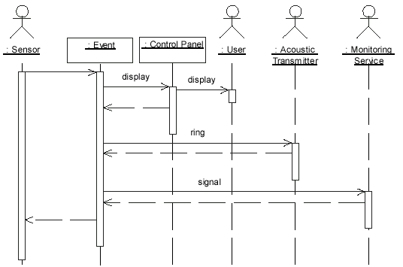
Sequence Example: Alarm System
When the alarm goes off, it rings the alarm, puts a message on the display, notifies the monitoring service

Slide 70
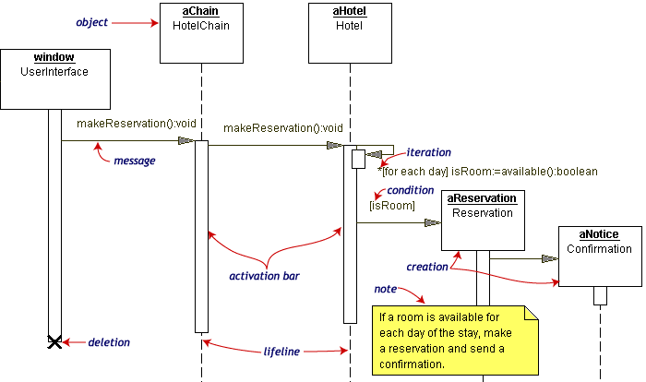
Sequence Diagram Example
Hotel Reservation

Slide 71
Collaboration Diagram
Collaboration Diagrams show similar information to sequence diagrams, except that the vertical sequence is missing. In its place are:
  Object Links - solid lines between the objects that interact
  On the links are Messages - arrows with one or more message name that show the direction and names of the messages sent between objects
Emphasis on static links as opposed to sequence in the sequence diagram

Slide 72
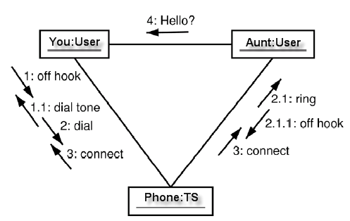
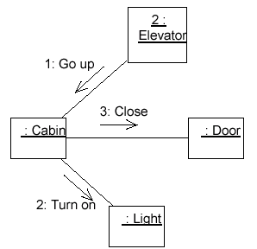
Collaboration Diagram

Slide 73


Activity Diagrams
Fancy flowchart
  Displays the flow of activities involved in a single process
  States
    Describe what is being processed
    Indicated by boxes with rounded corners
  Swim lanes
    Indicates which object is responsible for what activity
  Branch
    Transition that branch
    Indicated by a diamond
  Fork
    Transition forking into parallel activities
    Indicated by solid bars
  Start and End

Slide 74
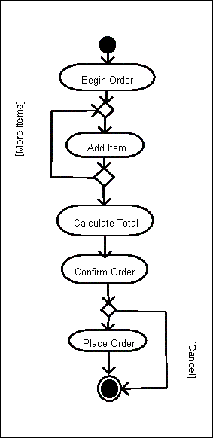
Sample Activity Diagram
Ordering System
May need multiple diagrams from other points of view

Slide 75

Activity Diagram Example

Slide 76
State Transition Diagrams
Fancy version of a DFA
Shows the possible states of the object and the transitions that cause a change in state
  i.e. how incoming calls change the state
Notation
  States are rounded rectangles
  Transitions are arrows from one state to another. Events or conditions that trigger transitions are written beside the arrows.
  Initial and Final States indicated by circles as in the Activity Diagram
    Final state terminates the action; may have multiple final states

Slide 77
State Representation
The set of properties and values describing the object in a well defined instant are characterized by
  Name
  Activities (executed inside the state)
    Do/ activity
  Actions (executed at state entry or exit)
    Entry/ action
    Exit/ action
  Actions executed due to an event
    Event [Condition] / Action ^Send Event

Slide 78
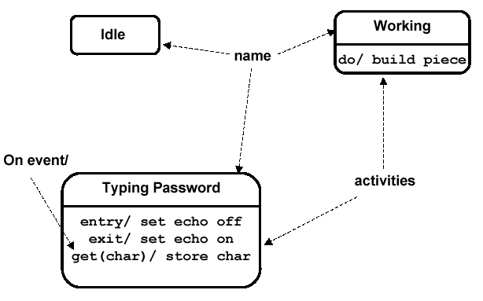
Notation for States

Slide 79
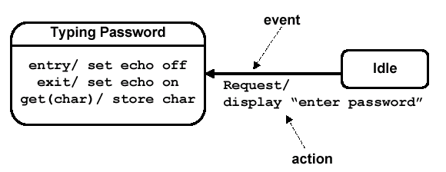
Simple Transition Example

Slide 80
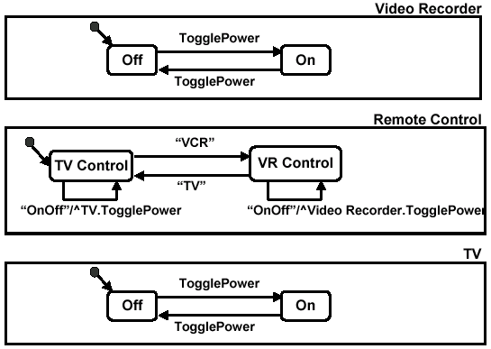
More Simple State Examples

Slide 81
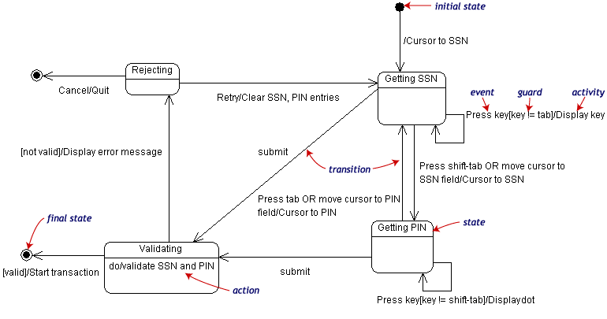
State Transition Example
Validating PIN/SSN

Slide 82
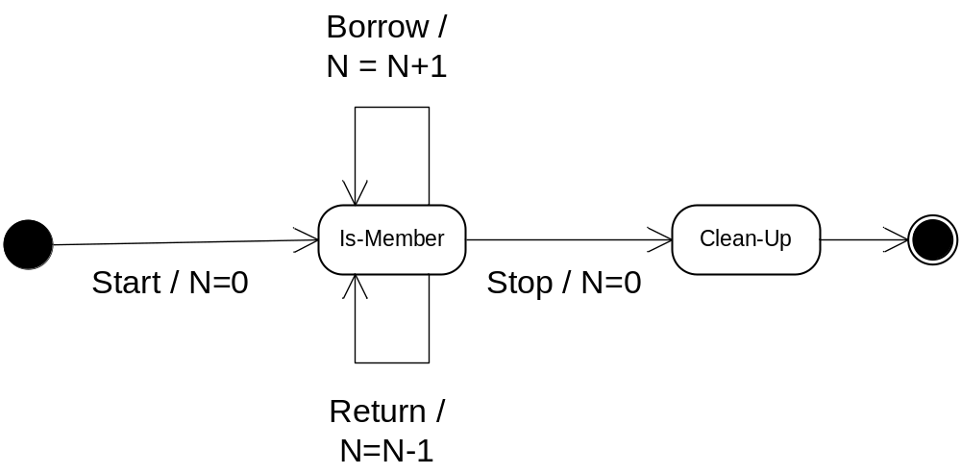
State Charts – Local Variables
State Diagrams can also store their own local variables, do processing on them
Library example counting books checked out and returned

Slide 83
Component Diagrams
Shows various components in a system and their dependencies, interfaces
Explains the structure of a system
Usually a physical collection of classes
  Similar to a Package Diagram in that both are used to group elements into logical structures
  With Component Diagrams all of the model elements are private with a public interface whereas Package diagrams only display public items.

Slide 84


Component Diagram Notation
Components are shown as rectangles with two tabs at the upper left
Dashed arrows indicate dependencies
Circle and solid line indicates an interface to the component

Slide 85
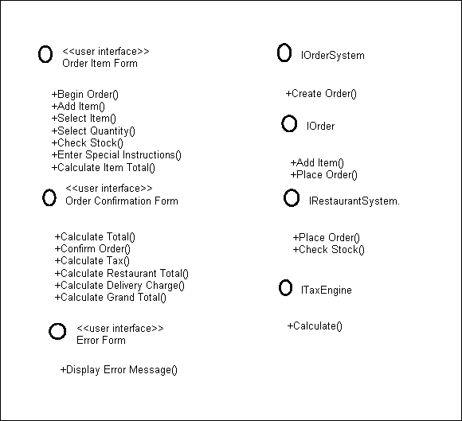
Component Example - Interfaces
Restaurant ordering system
Define interfaces first – comes from Class Diagrams

Slide 86
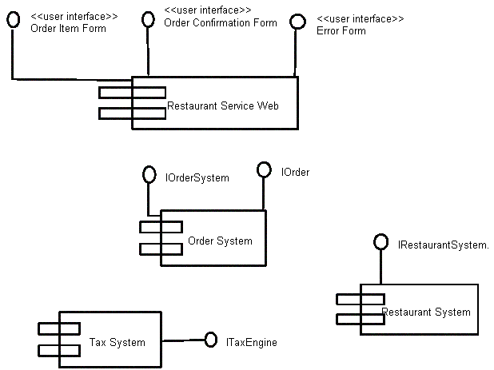
Component Example - Components
Graphical depiction of components

Slide 87
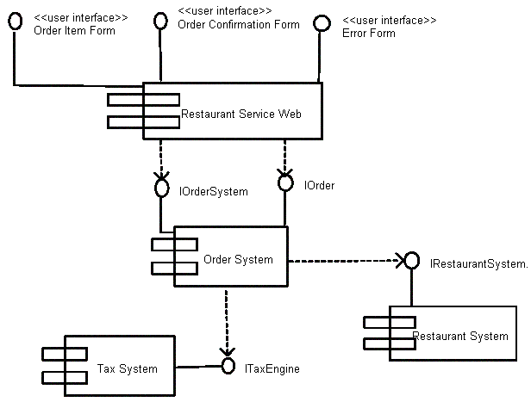
Component Example - Linking
Linking components with dependencies

Slide 88
Deployment Diagrams
Shows the physical architecture of the hardware and software of the deployed system
Nodes
  Typically contain components or packages
  Usually some kind of computational unit; e.g. machine or device (physical or logical)
Physical relationships among software and hardware in a delivered systems
  Explains how a system interacts with the external environment

Slide 89
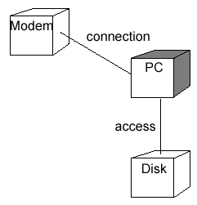
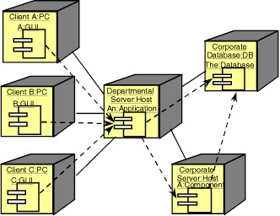
Some Deployment Examples

Slide 90
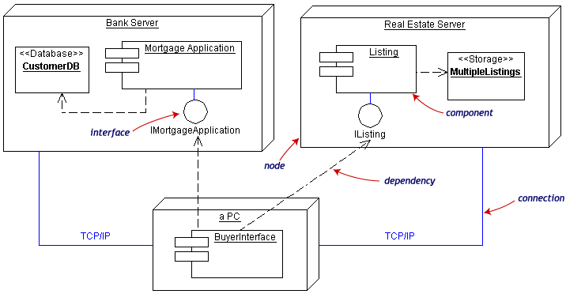
Deployment Example
Often the Component Diagram is combined with the Deployment

Slide 91
Summary and Tools
UML is a modeling language that can be used independent of development
Adopted by OMG and notation of choice for visual modeling
  http://www.omg.org/uml/
Creating and modifying UML diagrams can be labor and time intensive.
Lots of tools exist to help
  Tools help keep diagrams, code in sync
  Repository for a complete software development project
  Examples here created with TogetherSoft ControlCenter, Microsoft Visio, Tablet UML
  Other tools:
    Rational, Cetus, Embarcadero
    See http://plg.uwaterloo.ca/~migod/uml.html for a list of tools, some free

